Slide 1
Squish for Python

Slide 2
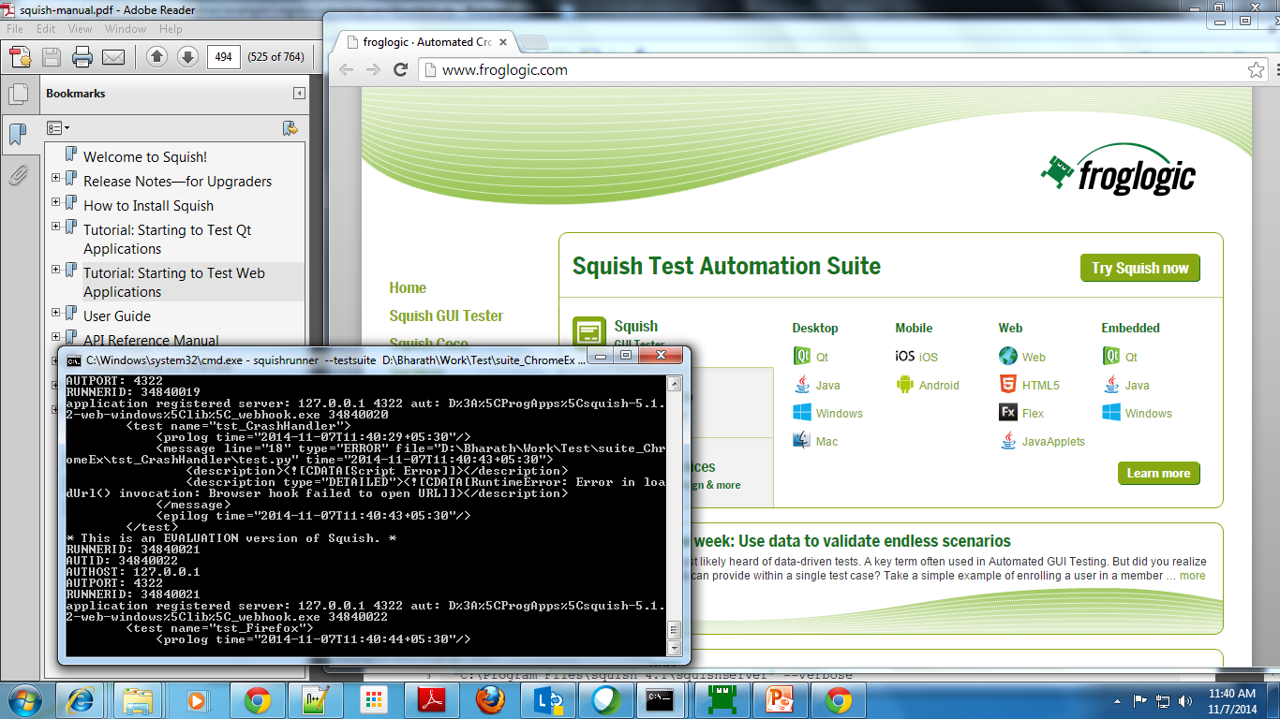
Running Scripts from Commandline
Run from Commandline like
D:\ProgApps\squish-5.1.2-web-windows\bin>squishrunner --testsuite D:\Bharath\Work\Test\suite_ChromeEx --reportgen xml2.1 New.log
Edit D:\ProgApps\squish-5.1.2-web-windows\examples\regressiontesting\squishruntests.py
  SQUISHDIR = ~/D:\ProgApps\squish-5.1.2-web-windows
  RESULTSDIR = ~/C:\Users\vikram.uk\Documents\Squish Test Results
  HOSTS = 127.0.0.1
  SUITES = ~/D:\Bharath\Work\Test\suite_ChromeEx \\
  PRESERVE = 0
  ISO = 1

Slide 3

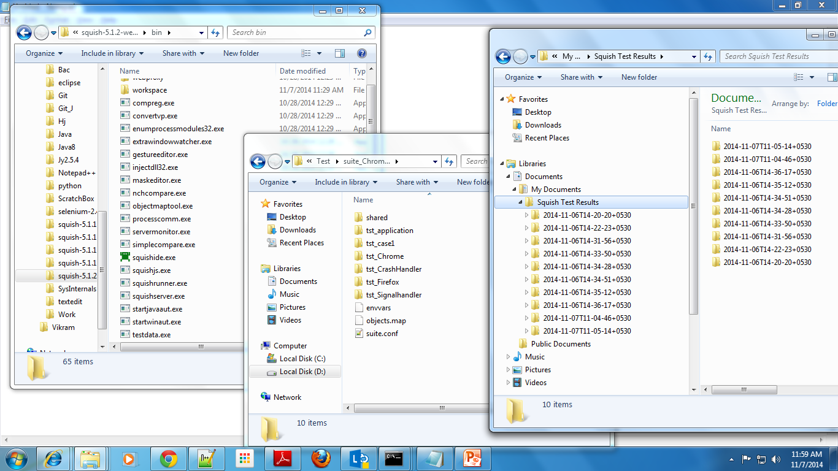
Folder Structures
Results
Scripts
Application

Slide 4
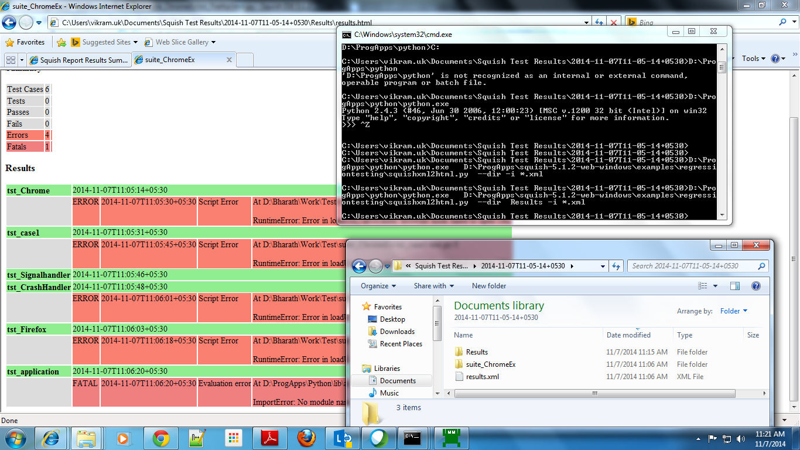
Results from Commandline
C:\Users\vikram.uk\Documents\Squish Test Results\2014-11-07T11-05-14+0530>D:\Pro
gApps\python\python.exe D:\ProgApps\squish-5.1.2-web-windows\examples\regressi
ontesting\squishxml2html.py --dir Results -i *.xml

Slide 5
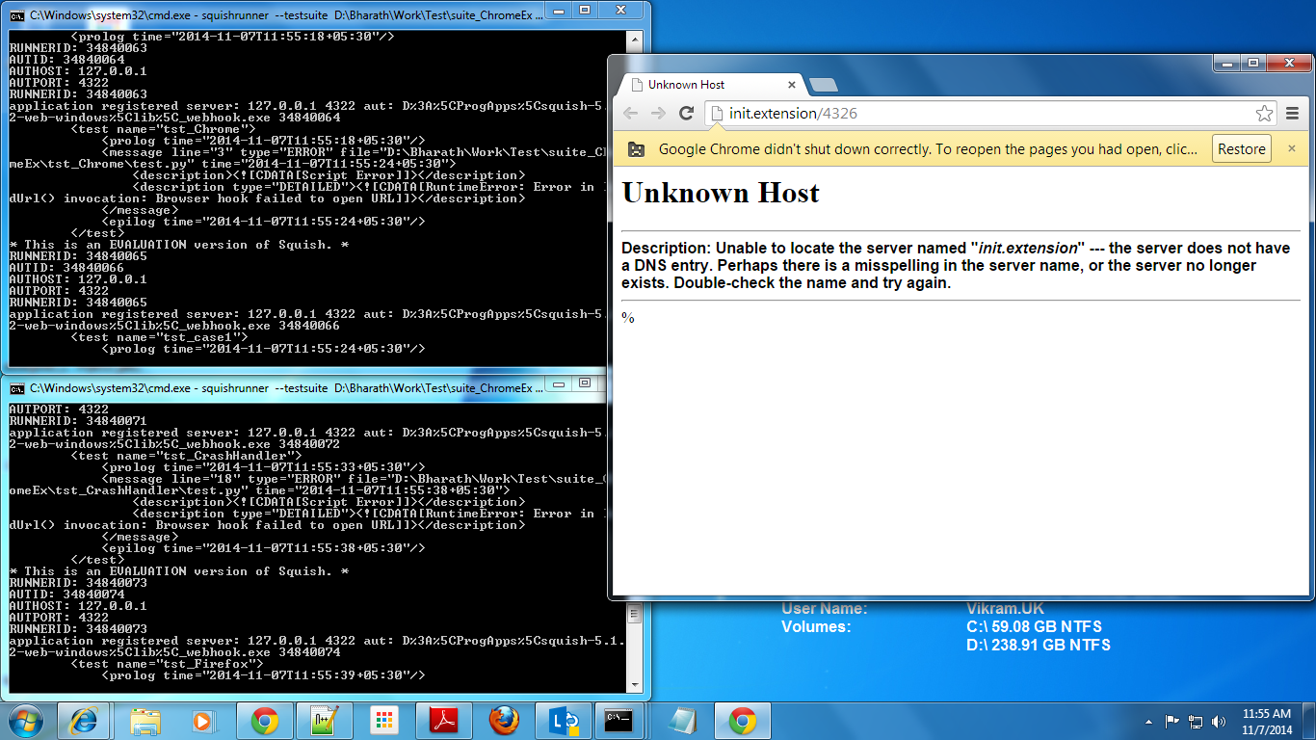
Multiple SquishRunner Scripts

Slide 6
Application Object : Checkbox

Slide 7
Application Object : Selection Box

Slide 8
Application Object : Text Box

Slide 9
Object Properties: Visible or Invisible

Slide 10
Application Object : KeyWord from ExcelBox

Slide 11
Xpath for waitForObject

Slide 12
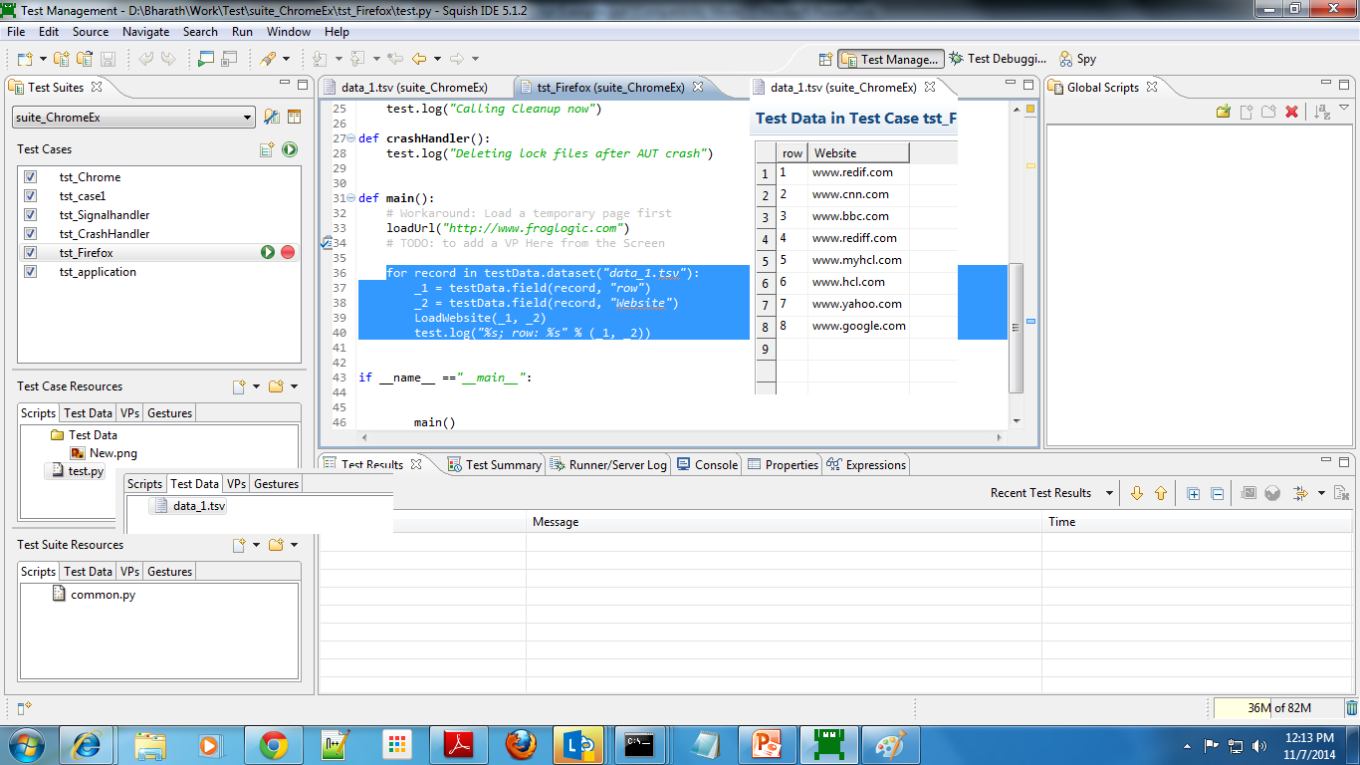
Squish Datadriven testing
for record in testData.dataset("data_1.tsv"):
_1 = testData.field(record, "row")
_2 = testData.field(record, "Website")
LoadWebsite(_1, _2)
test.log("%s; row: %s" % (_1, _2))

